Slide 1



Churn Prediction using Logistic Regression

Slide 2

Churn Prediction using Logistic Regression
Churn Prediction Problem
What is?
How to solve?
Why?
2

Slide 3
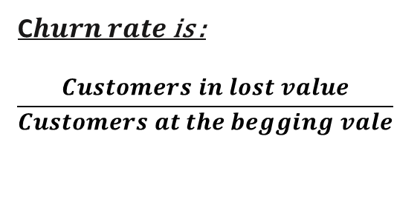
Churn Prediction, What is? Why? How to Solve?
What is?
What is?
Why?
How to solve?
The customer leave or "churn" the telecom service provider to another
Customer no longer values the product
Value to the customer does not justify the expense
The customer has found/switched to an alternative solution
Damage to product reputation
Improved Retention Strategies
Cost Savings
Enhanced Customer Experience
Data-Driven Decision-Making
Sustainable Growth
Feedback Loop
How Calculated?
C$hurn rate$is :
$$\frac{Customers in lost value}{Customers at the begging vale}$$
Notes:
Customer no longer values the product
—Whatever first attracted the customer to the product and inspired initial usage is no longer present. This could be a change in customer priorities or a change in the product itself.
Value to the customer does not justify the expense—The ROI for the customer is no longer there.
The customer has found/switched to an alternative solution—This may be a direct competitor or an indirect alternative that is free or already available (i.e. instead of a reminder app the customer will just write down their notes on paper).
Damage to product reputation—This could be a cybersecurity issue, noteworthy performance problems, terrible customer service or bad acts by the company or company employees.
Improved Retention Strategies: Churn analysis helps identify at-risk customers, enabling companies to develop targeted retention strategies.
Cost Savings: Retaining existing customers is often more cost-effective than acquiring new ones. Churn analysis helps allocate resources wisely.
Enhanced Customer Experience: Understanding the reasons for churn allows companies to address pain points and improve the customer experience.
Data-Driven Decision-Making: Churn analysis provides data-driven insights, allowing businesses to make informed decisions.
Sustainable Growth: By reducing churn, companies can maintain customer base and revenue growth over time.
6.Feedback Loop: Churn analysis can create a feedback loop between customer insights and product development teams, ensuring that customer needs and concerns are addressed in product roadmaps.

Slide 4






Churn Prediction, Structuring
2. Cleaning Data
8. Churn Prediction Results
9. Business Recommendations
7. Modeling, Model Evaluation
1. Raw
Data
3. Exploratory Data Analysis (EDA)
It is done by Hypothesis test, Categorical data, Numerical data, distribution of data, identify patterns, correlations, and trends.
6. Feature Importance Analysis
10. Data Visualization II
5. Feature Engineering
4. Data Visualization I

Slide 5

Churn Prediction, Cleaning Data
Dealing with Text Data
Handle Missing Values, identify null values
Remove Duplicates
Identify Outliers
Identify Data Quality Issues
Handle Categorical Data
Check Data Integrity
Check unbalanced data
Its done by pandas and numpy libs

Slide 6
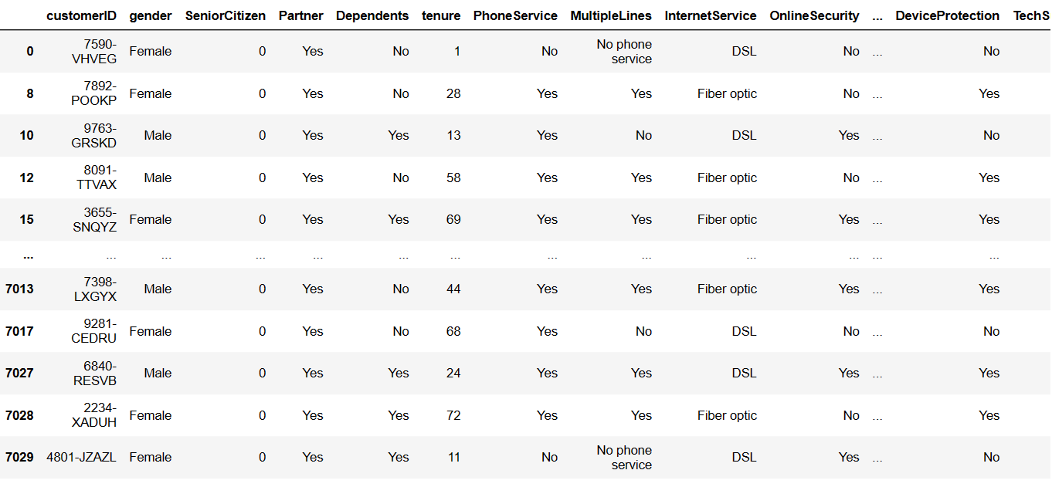
Churn Prediction, Data before cleaning

Slide 7
Churn Prediction, Data Description & Datatypes
Feature Name | Description | Data Type
customerID | Customer ID | categorical
gender | Whether the customer is a male or a female | categorical
SeniorCitizen | Whether the customer is a senior citizen or not (1, 0) | numeric, int
Partner | Whether the customer has a partner or not (Yes, No) | categorical
Dependents | Whether the customer has dependents or not (Yes, No) | categorical
tenure | Number of months the customer has stayed with the company | numeric, int
PhoneService | Whether the customer has a phone service or not (Yes, No) | categorical
MultipleLines | Whether the customer has multiple lines or not (Yes, No, No phone service) | categorical
InternetService | Customer’s internet service provider (DSL, Fiber optic, No) | categorical
OnlineSecurity | Whether the customer has online security or not (Yes, No, No internet service) | categorical
OnlineBackup | Whether the customer has online backup or not (Yes, No, No internet service) | categorical
DeviceProtection | Whether the customer has device protection or not (Yes, No, No internet service) | categorical
TechSupport | Whether the customer has tech support or not (Yes, No, No internet service) | categorical
StreamingTV | Whether the customer has streaming TV or not (Yes, No, No internet service) | categorical
StreamingMovies | Whether the customer has streaming movies or not (Yes, No, No internet service) | categorical
Contract | The contract term of the customer (Month to Month, One Year, Two Years) | categorical
PaperlessBilling | Whether the customer has paperless billing or not (Yes, No) | categorical
PaymentMethod | The customer’s payment method (Electronic check, Mailed check, Bank transfer (automatic), Credit card (automatic)) | categorical
MonthlyCharges | The amount charged to the customer monthly | numeric , int
TotalCharges | The total amount charged to the customer | object
Churn | Whether the customer churned or not (Yes or No) | categorical

Slide 8
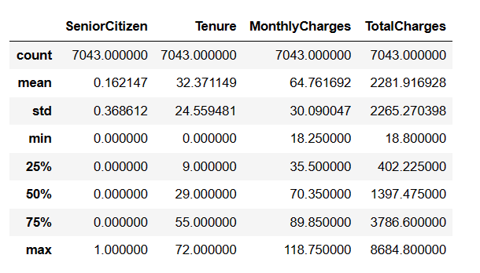
Churn Prediction, Exploratory Data Analysis (EDA)
The data has 7043 rows, with 14 features
Categorical Data ( m = 10 )
Numerical Data ( m = 4 )
Gender | object
Partner | object
Dependents | object
PhoneService | object
MultipleLines | object
InternetService | object
OnlineSecurity | object
OnlineBackup | object
DeviceProtection | object
TechSupport | object
StreamingTV | object
StreamingMovies | object
Contract | object
PaperlessBilling | object
PaymentMethod | object
SeniorCitizen | int64
TotalCharges | float64
Tenure | int64
MonthlyCharges | float64

Slide 9
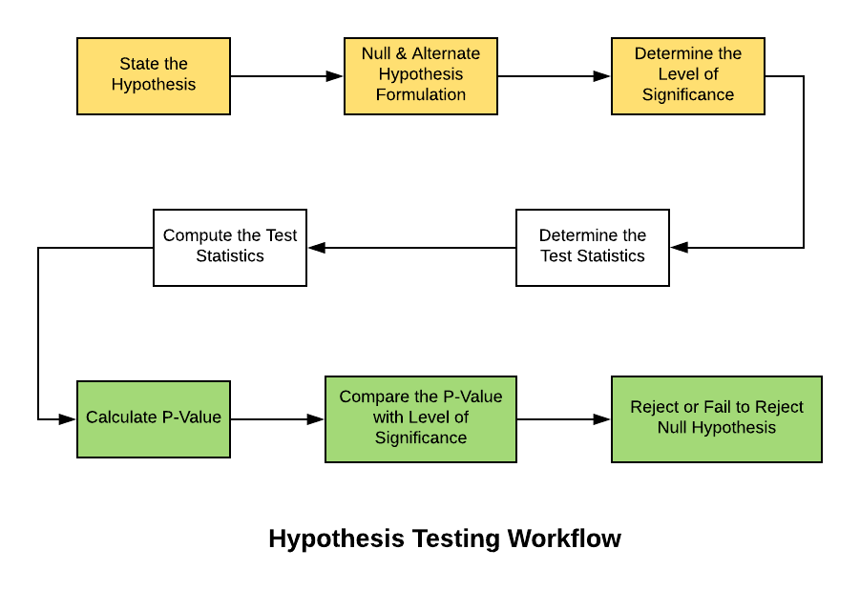
Churn Prediction, Exploratory Data Analysis (EDA)
& Hypothesis Test

Slide 10
Churn Prediction, Hypothesis Test
Feature | P-value | Null Hypothesis | Conclusion
Gender | 0.4866 | Fail to reject | No significant relationship with Churn
Partner | 0 | Reject | Significant relationship with Churn
Dependents | 0 | Reject | Significant relationship with Churn
PhoneService | 0.3388 | Fail to reject | No significant relationship with Churn
MultipleLines | 0.0008 | Reject | Significant relationship with Churn
InternetService | 0 | Reject | Significant relationship with Churn
OnlineSecurity | 0 | Reject | Significant relationship with Churn
OnlineBackup | 0 | Reject | Significant relationship with Churn
TechSupport | 0 | Reject | Significant relationship with Churn
DeviceProtection | 0 | Reject | Significant relationship with Churn
StreamingTV | 0 | Reject | Significant relationship with Churn
StreamingMovies | 0 | Reject | Significant relationship with Churn
Contract | 0 | Reject | Significant relationship with Churn
PaperlessBilling | 0 | Reject | Significant relationship with Churn
PaymentMethod | 0 | Reject | Significant relationship with Churn

Slide 11
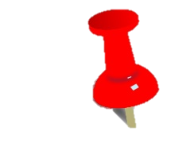
Churn Prediction, Hypothesis Test
P-value for Tenure: 0.0000
The p-value is very close to 0.
Rejecting the null hypothesis: This indicates that there is a significant relationship between the "Tenure" (length of time a customer has been with the company) and the likelihood of "Churn" (customer leaving).
Interpretation: The length of time a customer stays with the company (Tenure) is a significant factor influencing whether a customer will churn or not.
P-value for MonthlyCharges: 0.0000
The p-value is very close to 0.
Rejecting the null hypothesis: This indicates that there is a significant relationship between the "MonthlyCharges" (amount charged to the customer each month) and the likelihood of "Churn.“
Interpretation: The amount of monthly charges a customer incurs is a significant factor affecting the likelihood of churn.

Slide 12
Churn Prediction, Hypothesis Test
P-value for Contract: 0.0000
The p-value is very close to 0.
Rejecting the null hypothesis: This indicates that there is a significant relationship between the type of "Contract" (month-to-month, one year, two year) and the likelihood of "Churn.“
Interpretation: The type of contract a customer has with the company is a significant factor in determining whether a customer will churn.
P-value for OnlineSecurity: 0.0000
The p-value is very close to 0.
Rejecting the null hypothesis: This indicates that there is a significant relationship between the availability of "OnlineSecurity" and the likelihood of "Churn.“
Interpretation: The presence or absence of online security services for a customer is a significant factor affecting the likelihood of churn.

Slide 13

Churn Prediction, Hypothesis Test
P-value for TotalCharges: 0.5532
The p-value is relatively high (close to 0.5).
Failing to reject the null hypothesis: This indicates that there is no significant relationship between "TotalCharges" (total charges accumulated by the customer) and the likelihood of "Churn.“
Interpretation: The total charges a customer has accumulated over their entire tenure with the company do not have a significant impact on the likelihood of churn.
In summary:
The p-values reflect the statistical significance of the relationship between each of these features and the likelihood of churn.
A low p-value (typically less than 0.05) suggests that the relationship is significant, while a high p-value suggests that the relationship is not significant.
Rejecting the null hypothesis means that the feature has an impact on churn, while failing to reject it means that the feature does not have a significant impact.

Slide 14
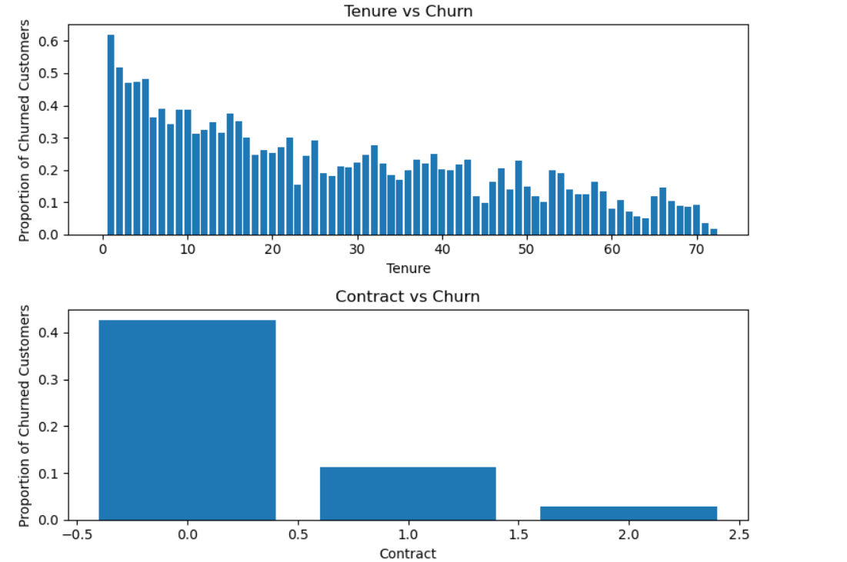
Churn Prediction, Hypothesis Test

Slide 15
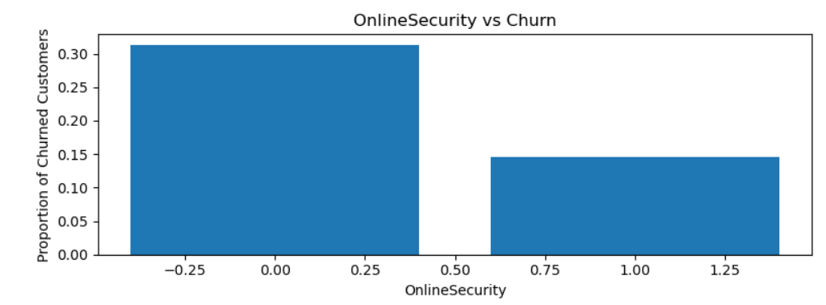
Churn Prediction, Hypothesis Test

Slide 16
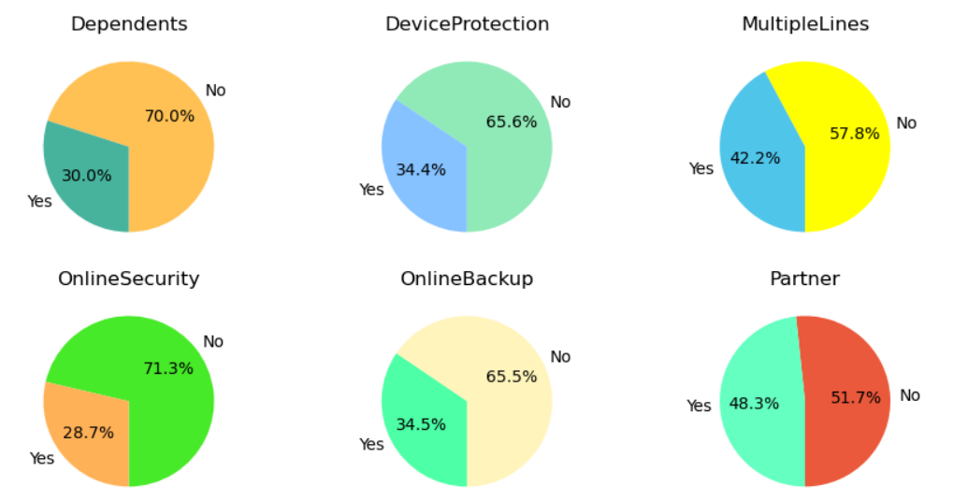
Churn Prediction, Data Visualizations I

Slide 17
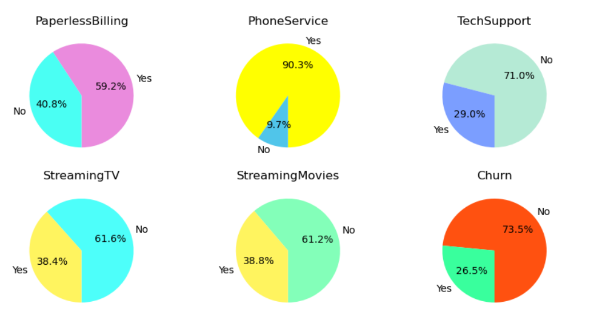
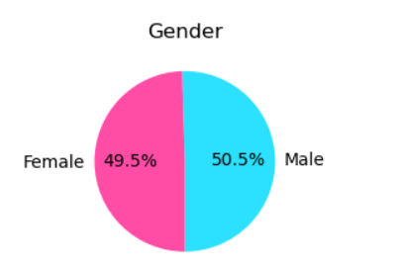
Churn Prediction, Data Visualizations I

Slide 18
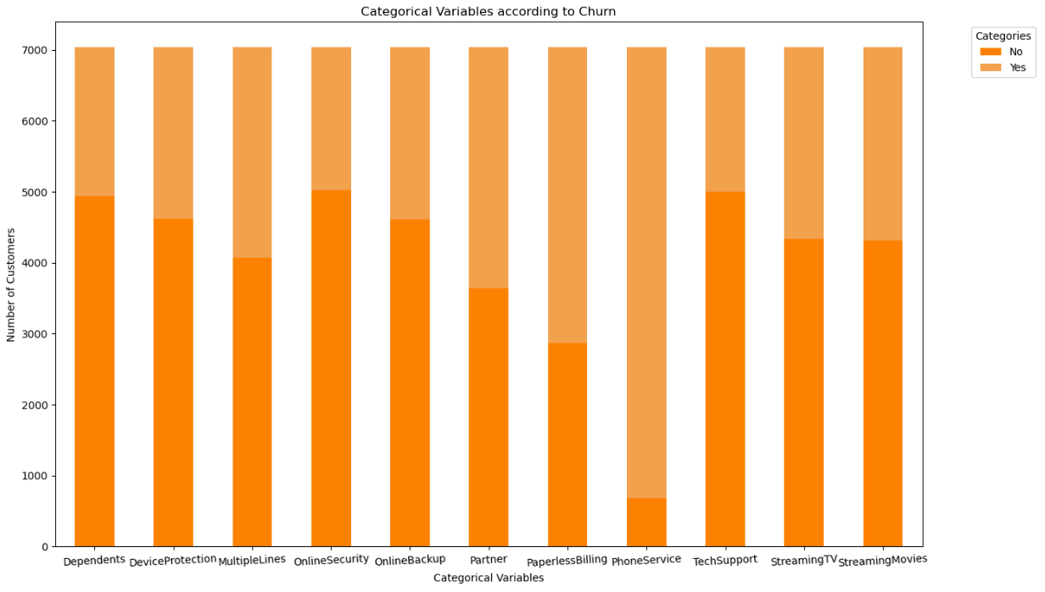
Churn Prediction, Data Visualizations I

Slide 19
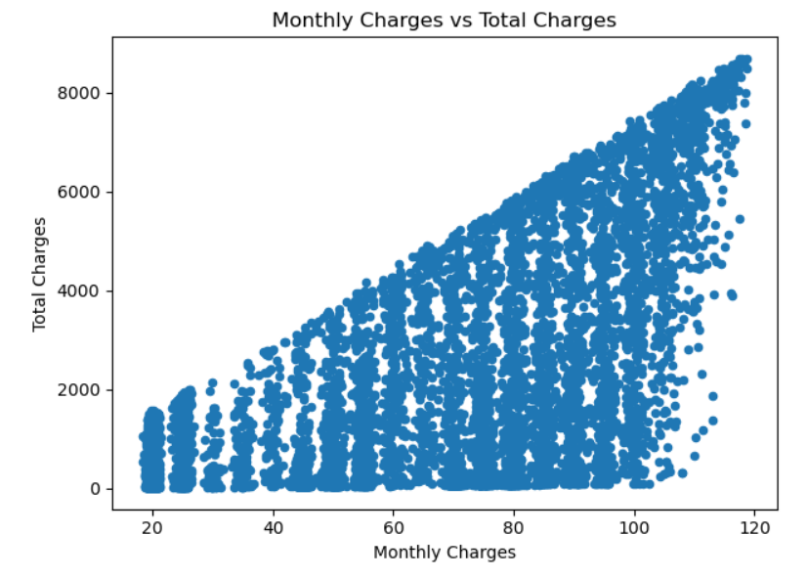
Churn Prediction, Data Visualizations I

Slide 20
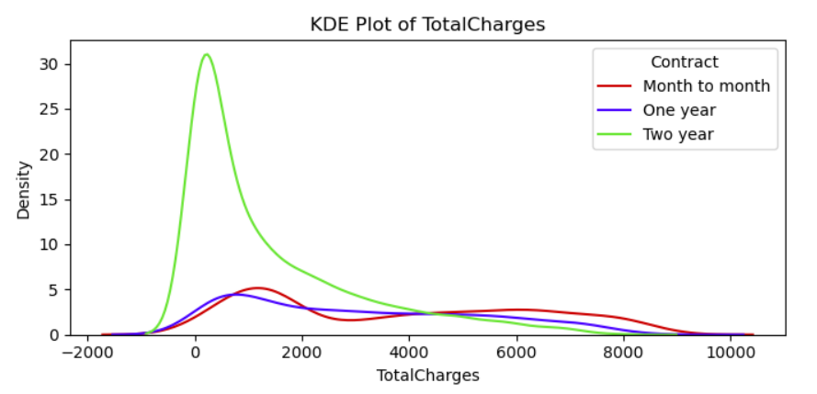
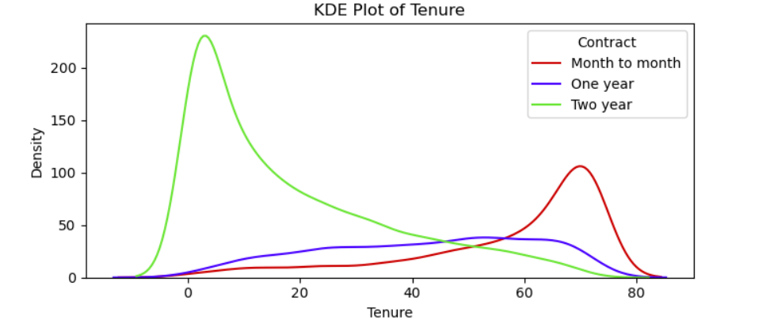
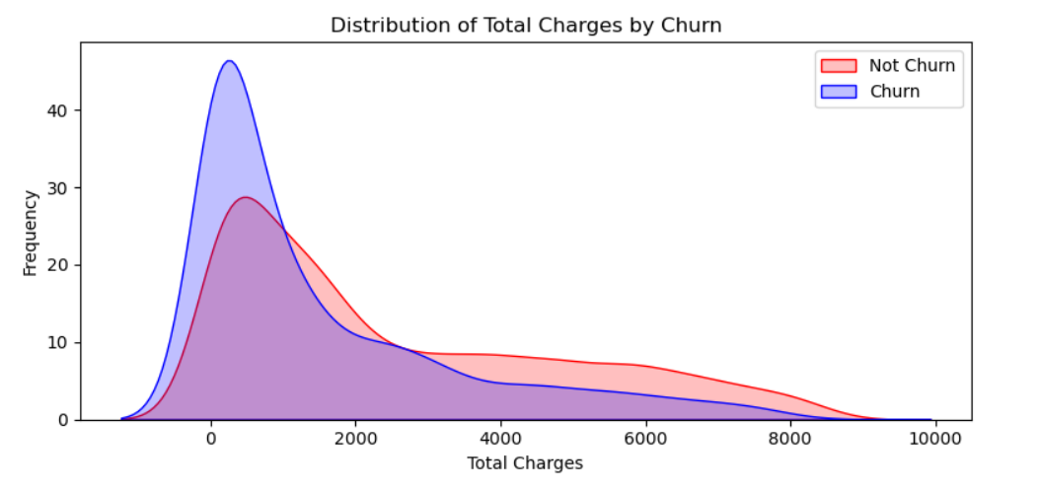
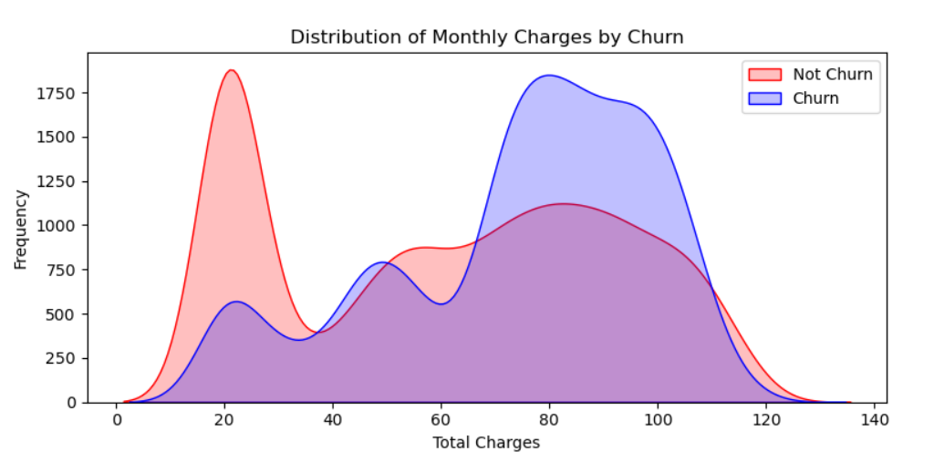
Churn Prediction, Data Visualizations I

Slide 21
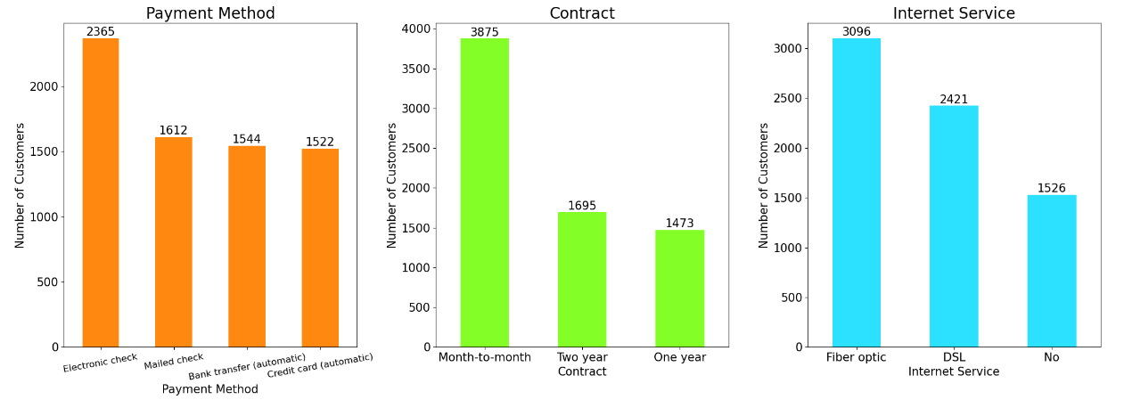
Churn Prediction, Data Visualizations I

Slide 22
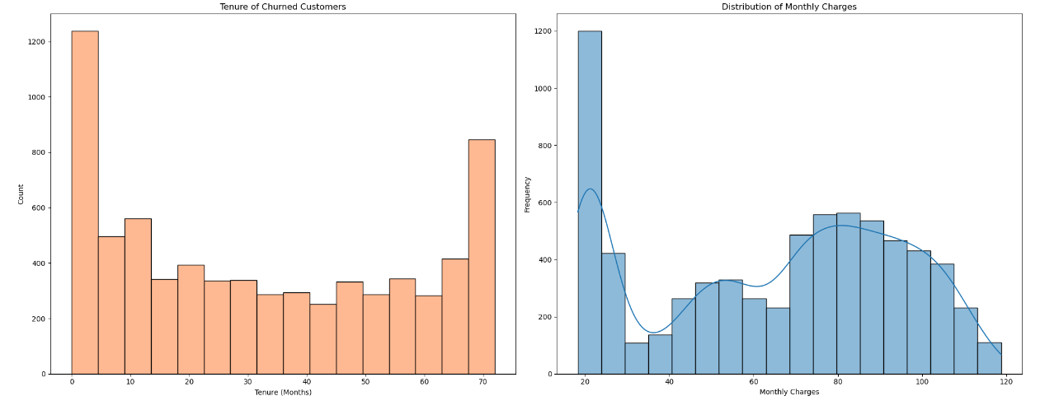
Churn Prediction, Data Visualizations I

Slide 23
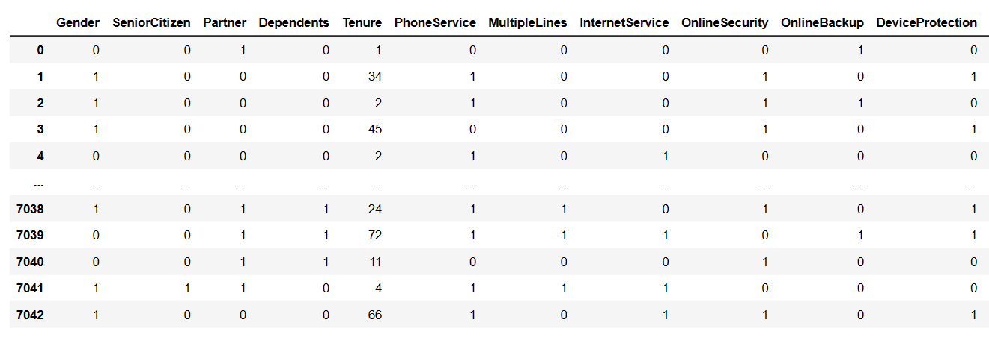
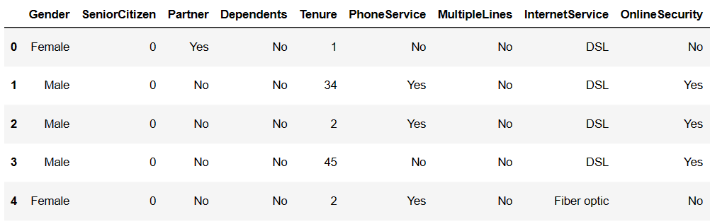


Churn Prediction, Modeling, Model Evaluation
Label
Encoder

Slide 24
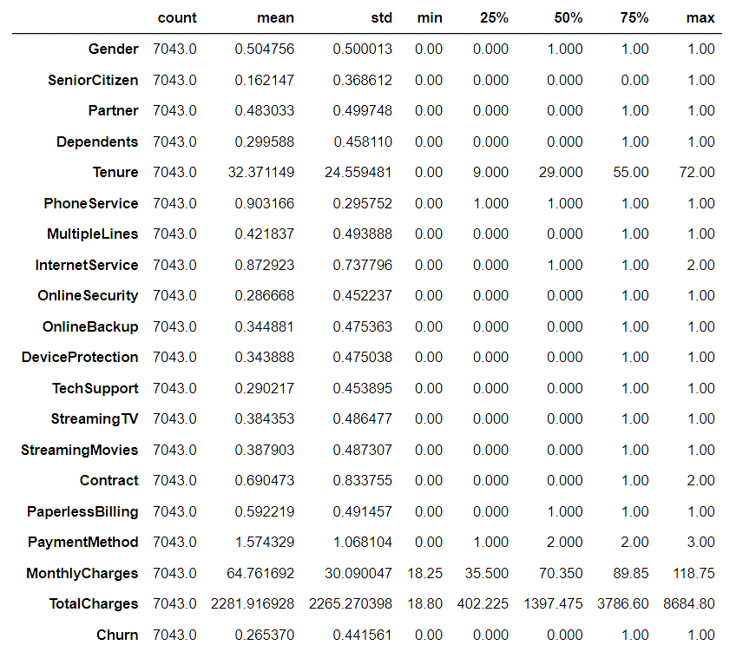
Churn Prediction, Modeling, Model Evaluation

Slide 25
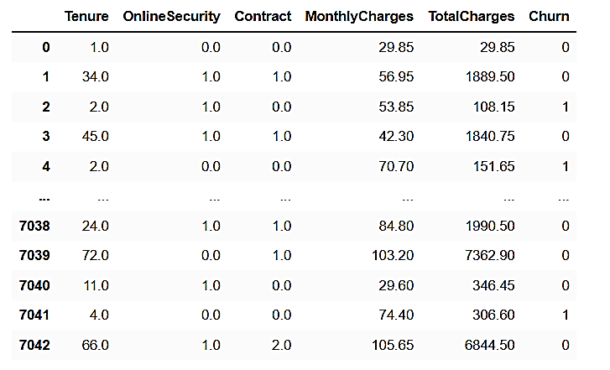
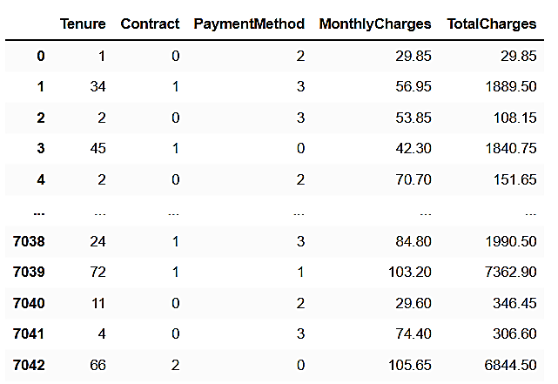
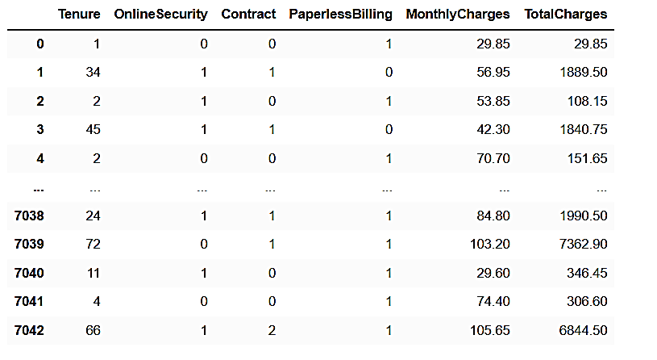
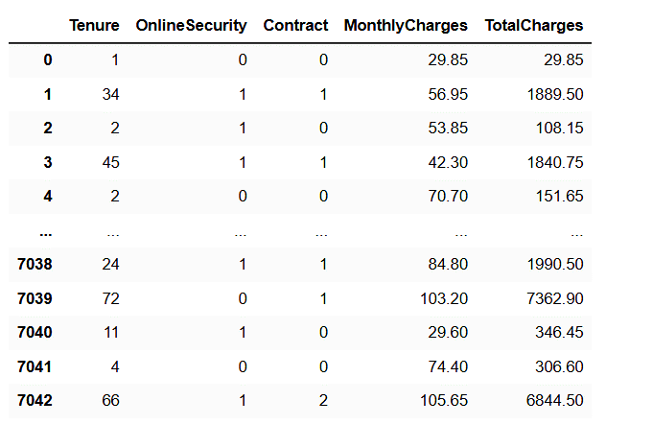
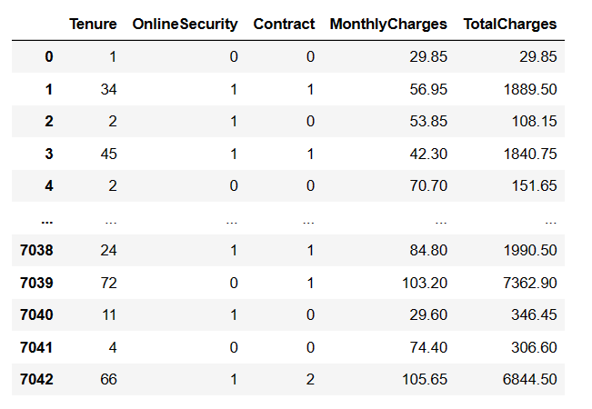
Churn Prediction, Select Features & Evaluation
Option 1
SelectKBest algorithm >> chi-squared test
Option 2
SelectFromModel >> RandomForestClassifier
Option 3
GenericUnivariateSelect >> f_classif test
Option 4
ExhaustiveFeatureSelector
Option 4
Greedy

Slide 26
Churn Prediction, Select Features & Evaluation
Select Feature By | Features |  |  |  |  |  | # of features | Accuracy by using Logistic Regression
Select K Best | Tenure | Contract | Monthly Charges | Total Charges | Online Security | Churn | 6 | -
Select From Model | Tenure | Contract | Monthly Charges | Total Charges | - | Payment Method | 5 | -
Generic Univariate Select | Tenure | Contract | Monthly Charges | Total Charges | Online Security | Paperless Billing | 6 | 0.799
Exhaustive Feature Selector | Tenure | Contract | Monthly Charges | Total Charges | Online Security | - | 5 | 0.78
Greedy | Tenure | Contract | Monthly Charges | Total Charges | Online Security | - | 5 | 0.76

Slide 27

Churn Prediction, Business Recommendations I
Feature-Specific Accuracy Calculation using Logistic RegressionThis code snippet focuses on calculating accuracy scores for specific features in a dataset using logistic regression. It defines a list of selected features, splits the dataset into training and testing sets, and then employs logistic regression to predict outcomes.
The accuracy score for each individual feature is computed and presented in percentage form. This approach provides insights into how well the logistic regression model performs for each feature independently.
Feature | Accuracy by Logistic Regression
Tenure | 75.09%
Contract | 75.30%
Monthly Charges | 75.30%
Total Charges | 75.30%
Online Security | 75.30%
Payment Method | 75.30%

Slide 28
Churn Prediction, Hypothesis Test & Feature Selection
Aspect | Hypothesis Testing | Feature Selection
Strengths | Formal and statistically rigorous Quantifies strength of evidence Tests specific hypotheses | Automated feature selection Helps prevent overfitting Reduces dimensionality
Use Cases | Testing specific hypotheses Understanding feature relationships | Large feature space Preprocessing for machine learning
Limitations | Ignores feature interactions Sensitive to sample size and assumptions | May not capture complex interactions Relies on predefined metrics
Example application | Testing relationship between each feature and target variable | Selecting top K most relevant features for modeling

Slide 29

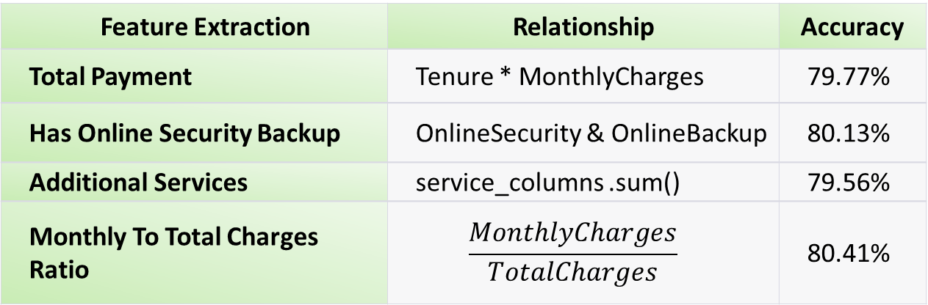
Churn Prediction, feature Extraction
Feature Extraction | Relationship | Accuracy
Total Payment | Tenure * MonthlyCharges | 79.77%
Has Online Security Backup | OnlineSecurity & OnlineBackup | 80.13%
Additional Services | service_columns .sum() | 79.56%
Monthly To Total Charges Ratio | $$\frac{MonthlyCharges}{TotalCharges}$$ | 80.41%

Slide 30

Churn Prediction, Assignment 1, Abstraction

Slide 31
Churn Prediction, Data Description & Datatypes
Feature Name | Description | Data Type
customerID | Customer ID | categorical
gender | Whether the customer is a male or a female | categorical
SeniorCitizen | Whether the customer is a senior citizen or not (1, 0) | numeric, int
Partner | Whether the customer has a partner or not (Yes, No) | categorical
Dependents | Whether the customer has dependents or not (Yes, No) | categorical
tenure | Number of months the customer has stayed with the company | numeric, int
PhoneService | Whether the customer has a phone service or not (Yes, No) | categorical
MultipleLines | Whether the customer has multiple lines or not (Yes, No, No phone service) | categorical
InternetService | Customer’s internet service provider (DSL, Fiber optic, No) | categorical
OnlineSecurity | Whether the customer has online security or not (Yes, No, No internet service) | categorical
OnlineBackup | Whether the customer has online backup or not (Yes, No, No internet service) | categorical
DeviceProtection | Whether the customer has device protection or not (Yes, No, No internet service) | categorical
TechSupport | Whether the customer has tech support or not (Yes, No, No internet service) | categorical
StreamingTV | Whether the customer has streaming TV or not (Yes, No, No internet service) | categorical
StreamingMovies | Whether the customer has streaming movies or not (Yes, No, No internet service) | categorical
Contract | The contract term of the customer (Month to Month, One Year, Two Years) | categorical
PaperlessBilling | Whether the customer has paperless billing or not (Yes, No) | categorical
PaymentMethod | The customer’s payment method (Electronic check, Mailed check, Bank transfer (automatic), Credit card (automatic)) | categorical
MonthlyCharges | The amount charged to the customer monthly | numeric , int
TotalCharges | The total amount charged to the customer | object
Churn | Whether the customer churned or not (Yes or No) | categorical

Slide 32
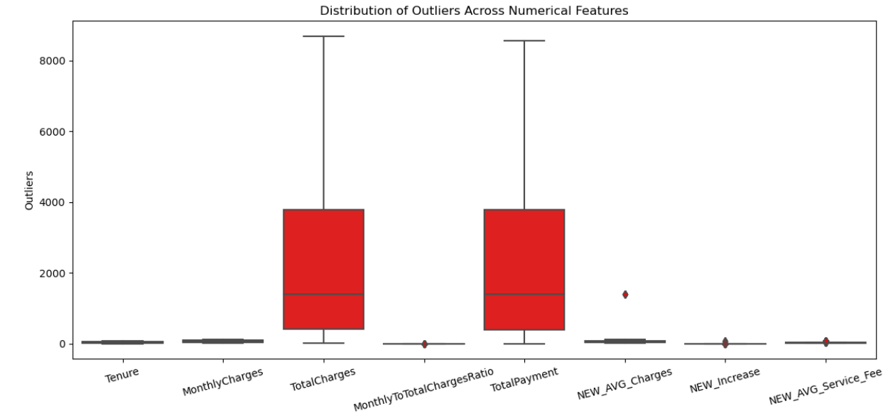
Churn Prediction, Outliers
Outliers, which are data points that significantly differ from the majority of the data in a dataset
Outliers, which are data points that significantly differ from the majority of the data in a dataset

Slide 33
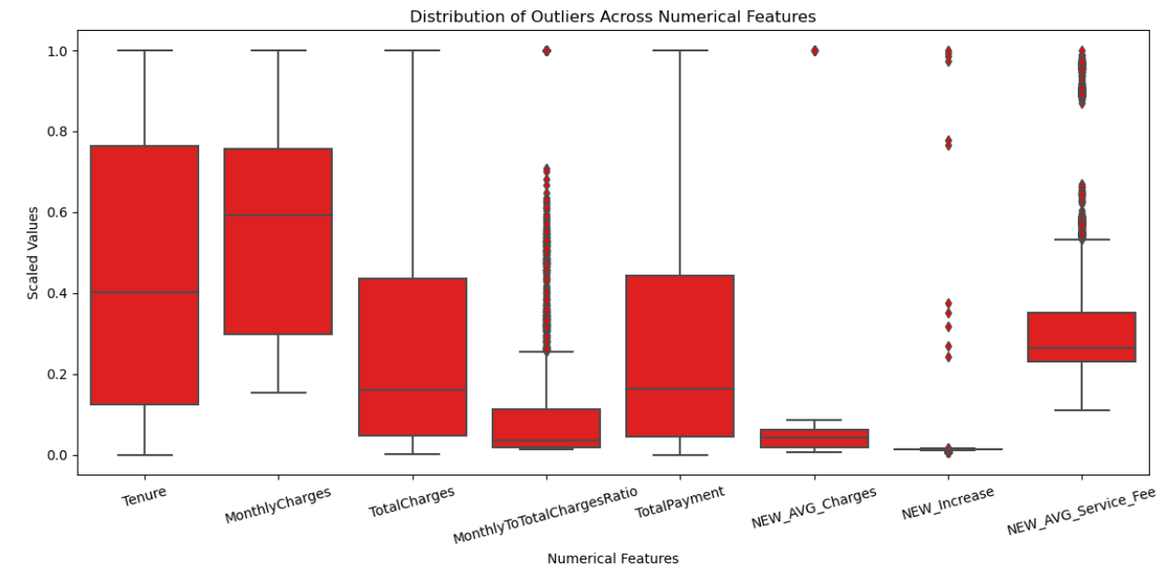
Churn Prediction, Outliers, Normalization(MaxAbsScaler)
MaxAbsScaler is normalize numerical features in a way that each feature's values lie within the range [-1, 1] without shifting the feature's distribution

Slide 34
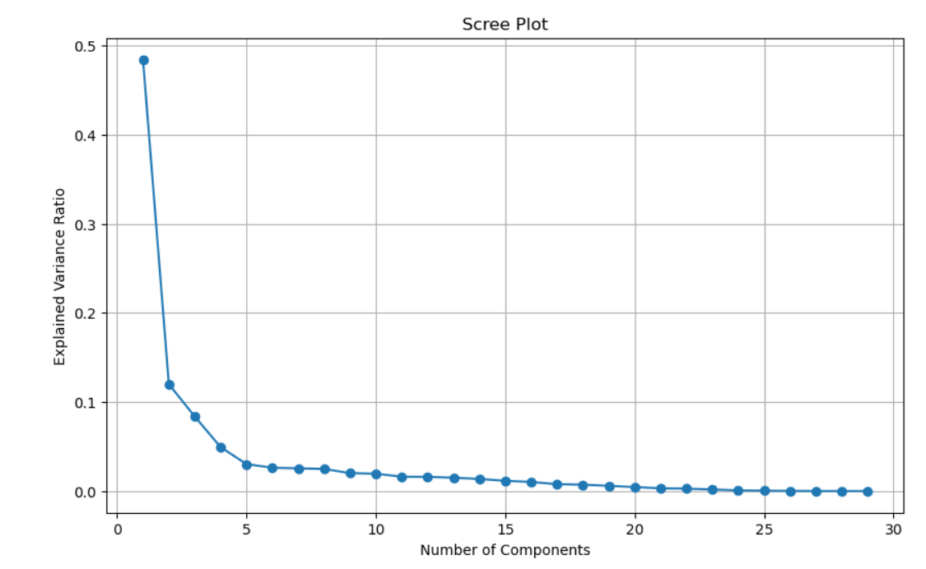
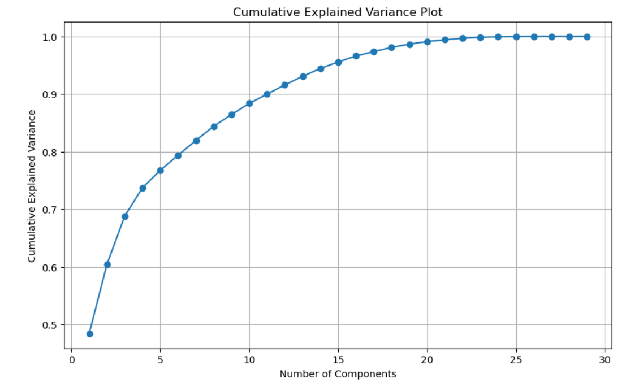
Churn Prediction, PCA, Important Features
We used two techniques for PCA to get the optimal number of features for churn prediction, as shown the below graphs we got a 5 features

Slide 35
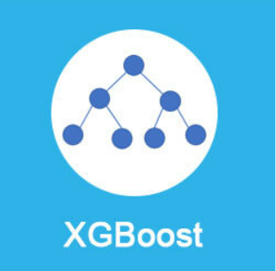
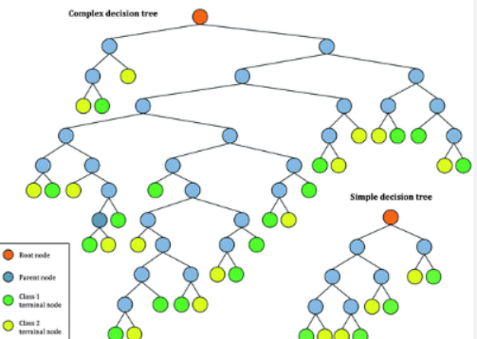
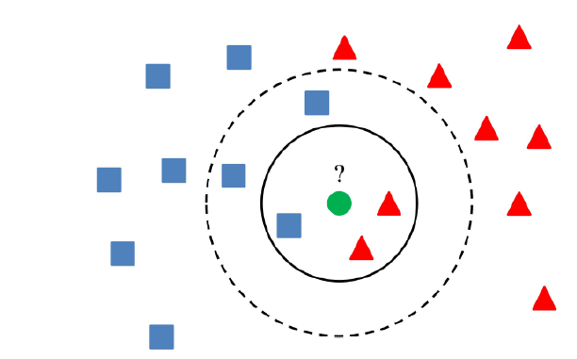
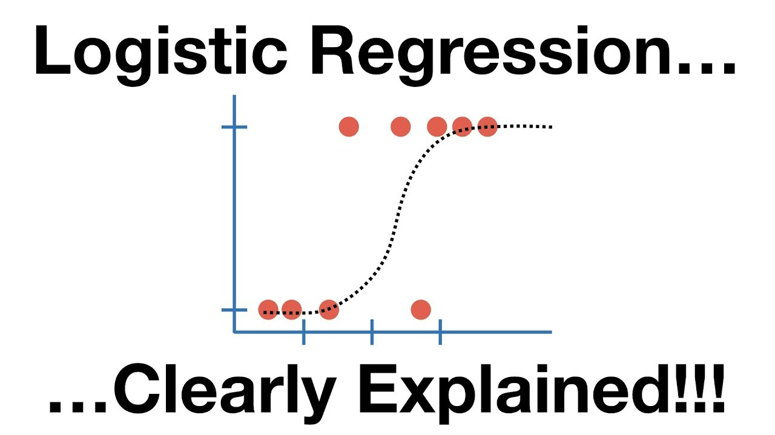
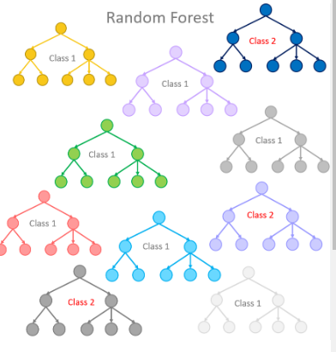
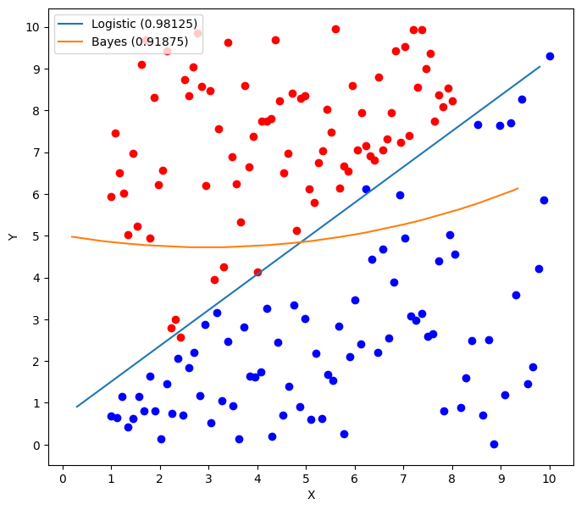
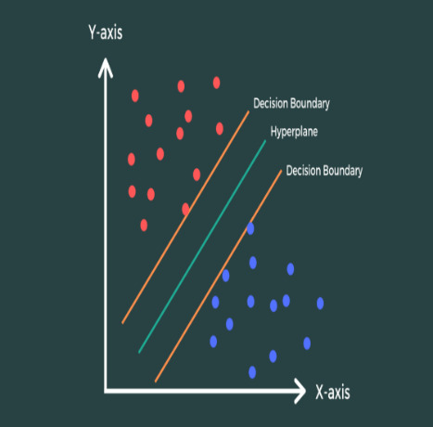
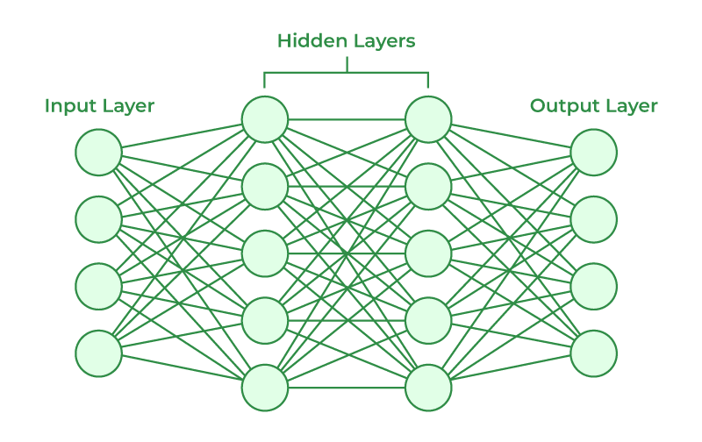
Churn Prediction, Select Model
There are a lot models for classification supervised ML, we are using these models:
XGBoost
CART
Kneighbors Classifier
Logistic Regression
NN
Random Forest
Gaussian NB
SVM

Slide 36
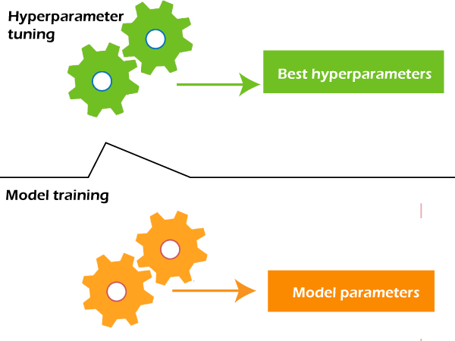
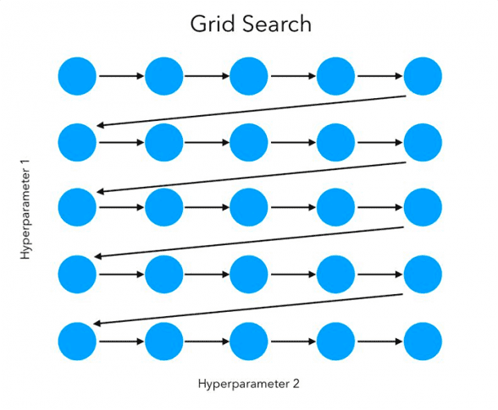
Churn Prediction, Grid Search and Hyperparameters
Grid Search is a technique used in machine learning to find the best combination of hyperparameter values for a given model. In our project we used RandomizedSearchCV

Slide 37
Churn Prediction, Select Model & Evaluation 1
ML Model | Accuracy before any normalization or PCA | Accuracy after normalization and PCA
Perceptron | 77.36% | 70.84%
Logistic Regression | 81.05% | 87.22%
Random Forest | 79.49% | 91.13%
CART | 74.02% | 87.8%
XGBOOT | 80.70% | 90.13%
NN | 76.93% | 88.43%
KNN | 68.20% | 81.05%
Naïve base | 77.71 | 89.9%
SVM | 77.36% | 70.84%
Best hyper parameters for random forest by using grid search | 'n_estimators': 300, 'min_samples_split': 2, 'min_samples_leaf': 1, 'max_features': 'sqrt', 'max_depth': 30, 'bootstrap': False
NN in Deep learning by using Relu and sigmoid functions | 92.3%

Slide 38
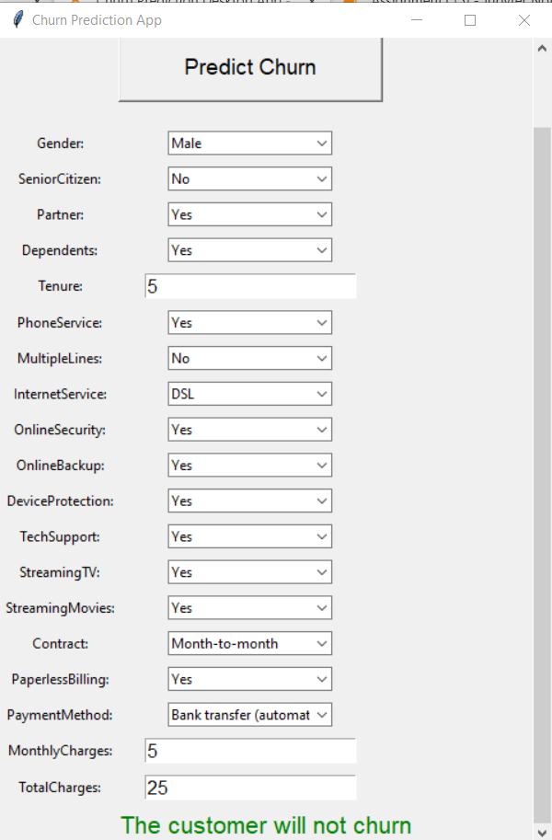

Churn Prediction, Desktop app before PCA
The Churn Prediction App is designed to help users predict whether a customer will churn.
It based on various input features
It serves as a user-friendly interface for running predictions using a pre-trained machine learning model.

Slide 39
Churn Prediction, Business Recommendations II
Feature Importance Analysis
Regular Model Maintenance
Resource Allocation
Identify High Churn-Risk Customers:
Customer Feedback Integration

